Slide 1
UEN002 – Energy and Environment
In the previous session, we went through…..
Sanitary landfills, disposal of solid waste and management of landfill sites

Slide 2
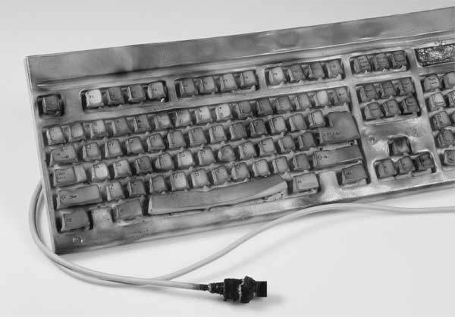
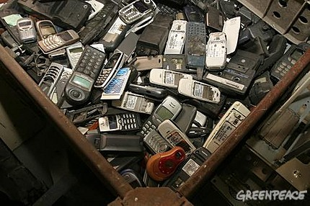
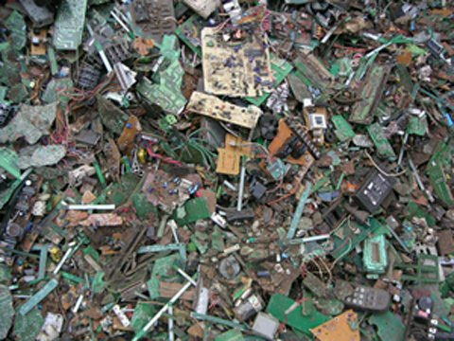
E-waste

Slide 3
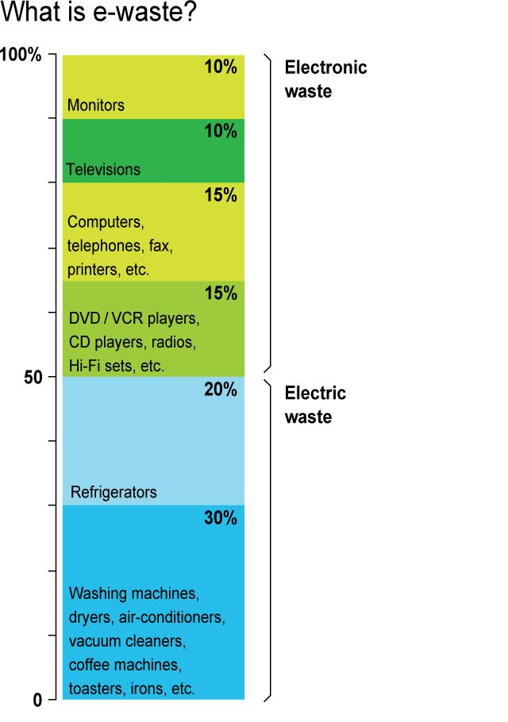
WHAT IS ELECTRONIC WASTE?
Electronic waste, "e-waste" or "Waste Electrical and Electronic Equipment" ("WEEE") is a waste consisting of any broken or unwanted electrical or electronic appliance.
It is a point of concern considering that many components of such equipment are considered toxic and are not biodegradable.

Slide 4
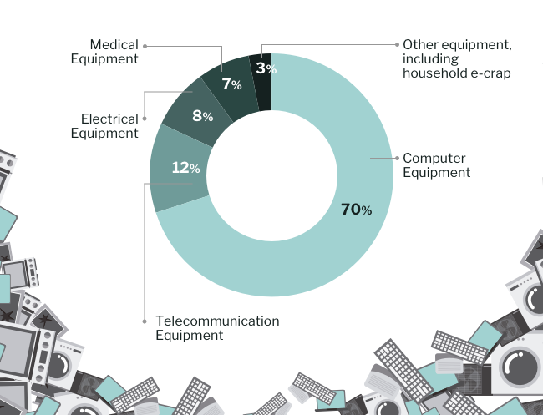
E-Waste: Main Sources
Imports;
Govt., public and private sector discards (over 70%);
PC retailers, manufacturers;
Secondary market of old PCs; and
Individual Households.
https://swachhindia.ndtv.com/india-world-top-5-e-waste-producer-assocham-nec-report-21415/

Slide 5
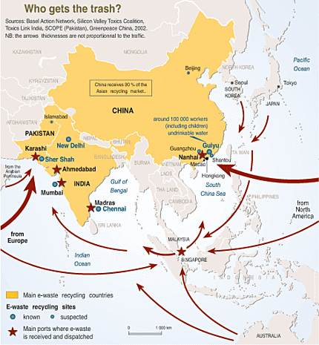

Slide 6
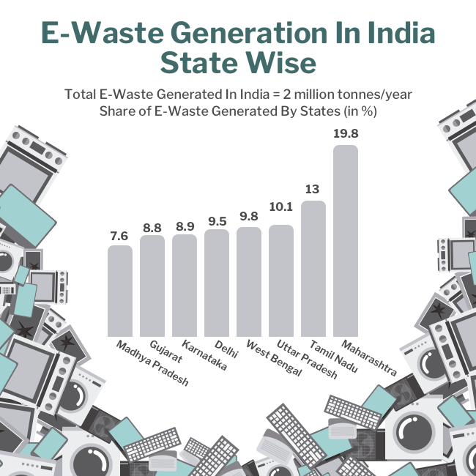
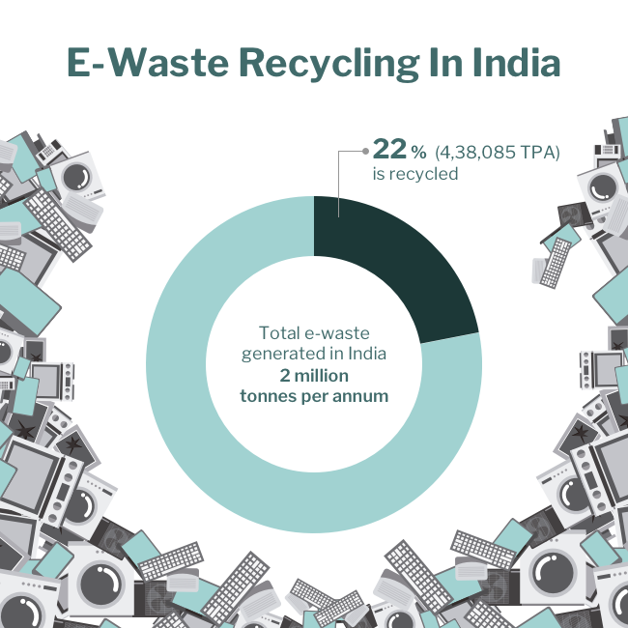
Effect of the E-Waste Trade
330000 tons imported/generated in 2009 of which 150000 tons in India
Jun, 2008- half ton e-waste generated in Mumbai per day
Sep, 2008- 10000 tonnes in Delhi per day
https://swachhindia.ndtv.com/india-world-top-5-e-waste-producer-assocham-nec-report-21415/

Slide 7
Classification: types of e-waste
Mobile Phones
Computers
Servers
Telecom
TV
Calculators
Audio
Scanners
Printers
Air Conditioner
Microwave
Washing Machine
Cartridges
Military electronic
Mother board
Alarm
Sirens
Automobile Catalytic Converter
Sensor
CD
Security Device

Slide 8
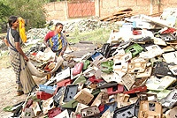
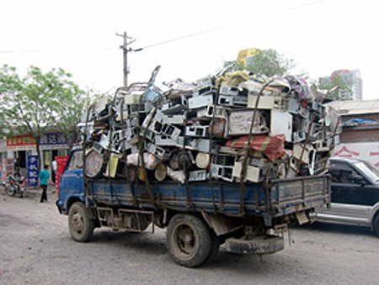
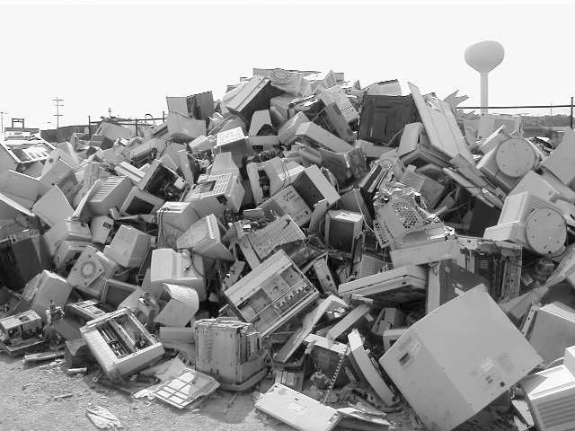
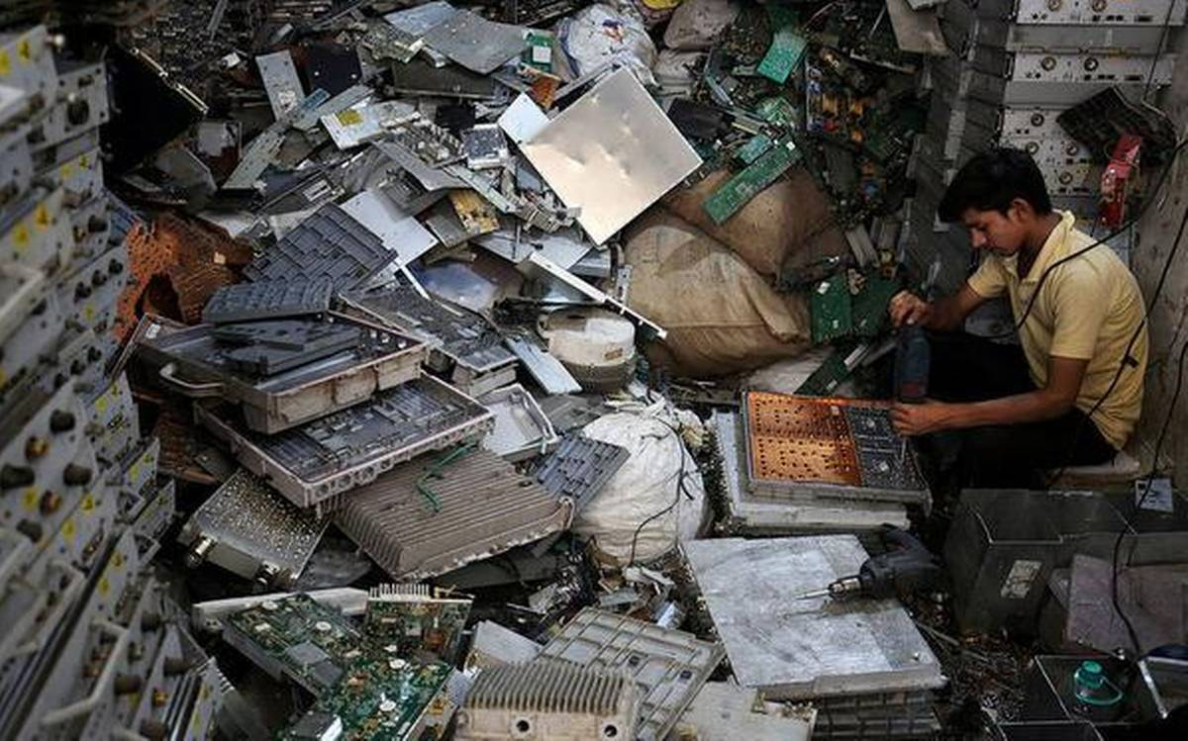
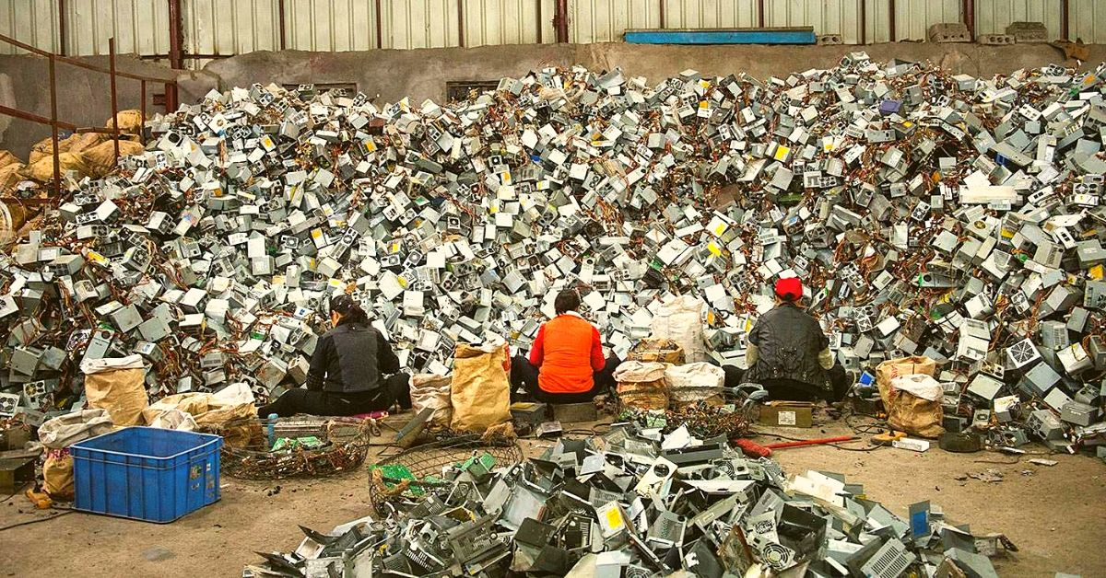
E-Waste handling by
Unorganized sector

Slide 9
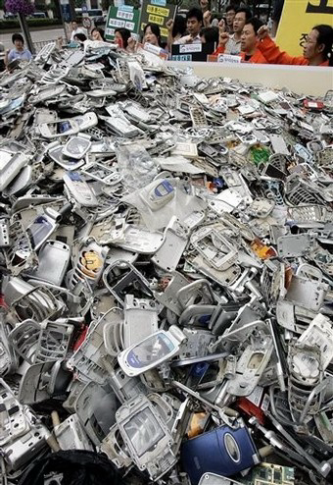
Discarded Mobiles - Nokia as an example

Slide 10
Mobile phones
World’s 80% population live in areas of cell phone reception
Over one billion cell phones sold worldwide in 2006
Discarded mobiles by Americans – 150 million phones i.e., 40000 phones / day
150 million phones consume energy that would power 250000 homes / yr.
Produce 258 million kgs of carbon.
2 % recycled

Slide 11
Mobile phones
Indians upgrade or exchange their cell phones every 18 months, meaning there are approximately 16 million unused mobile phones stashed away at home or in the office
Average working life of a mobile phone is 7 years but worldwide the average consumer changes their mobile every 11 months
Indians purchased 40 million mobile phones in past 5 years including 12.28 million in 2009
Based on 2009-2010 estimates, it is expected that that each year 130 million mobile phones in the US and 105 million mobile phones in Europe will be thrown away
700 million obsolete phones discarded in 2005 contained an estimated 560,000 kg of lead in the form of solder

Slide 12
Microsoft's new operating system launched in 2008-2009 -- Windows Vista and
Windows 7– has made many older machines obsolete and created a "tsunami of e-waste" exported to developing nations, according to Jim Puckett, coordinator for the Basel Action Network.

Slide 13
IS IT HAZARDOUS WASTE ?
E-Waste contains several different substances and chemicals, many of which are toxic and are likely to create adverse impact on environment and health, if not handled properly. However, classification of E-waste as hazardous or otherwise shall depend upon the extent of presence of hazardous constituents in it.

Slide 14
E-Waste Hazards
Two million Obsolete PCs would mean:
14,427,000 kg
3,962,700 kg
1,386 kg
819 kg
5,922 kg
3,969 kg
19,845 kg
9,891 kg
Average PC of approx. 31.5 kg wt. contains:
  7.24 kg - Plastics
  1.98 kg - Lead
  0.693g - Mercury
  0.4095g - Arsenic
  2.961g - Cadmium
  1.98g - Chromium
  9.92g - Barium
  4.94g - Beryllium

Slide 15
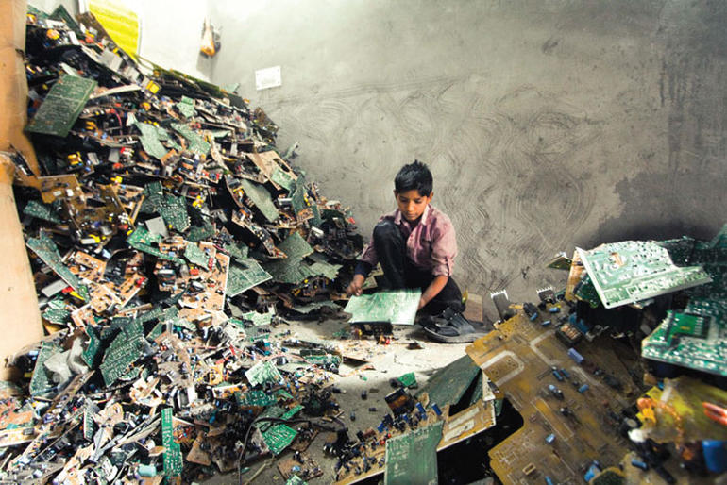
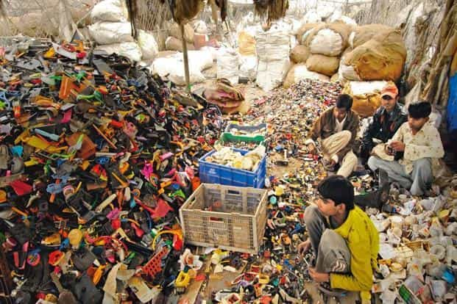
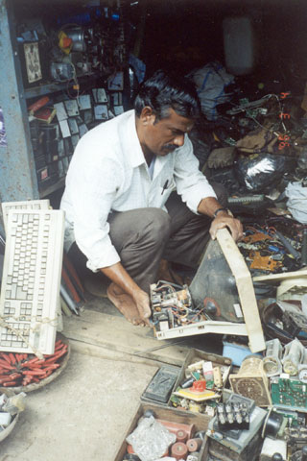
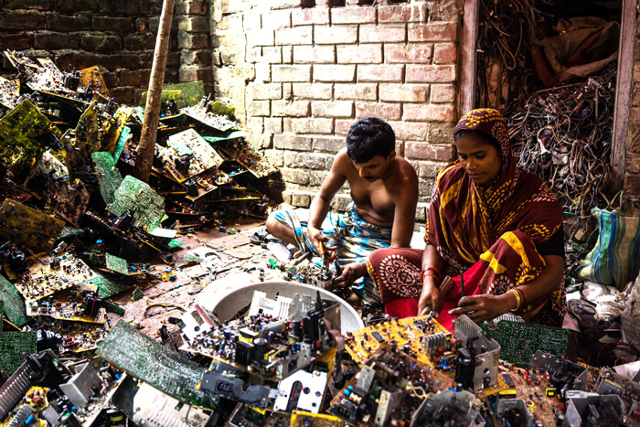
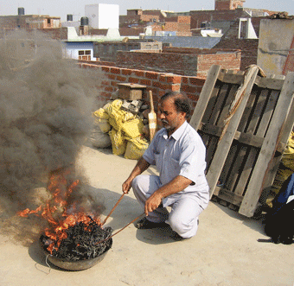
The process of metal extraction from these wastes release
more poisonous gases than pollution from other means

Slide 16
Effects On Human Health
Damage to central and peripheral nervous systems, blood systems and kidney damage.
Affects brain development of children.
Chronic damage to the brain.
Respiratory and skin disorders due to bioaccumulation in fishes.
Asthmatic bronchitis.
DNA damage.
Reproductive and developmental problems.
Immune system damage.
Lung Cancer.
Damage to heart, liver and spleen.

Slide 17
Effects on Environment
Pollution of Ground-Water.
Acidification of soil.
Air Pollution.
E-Waste accounts for 40 percent of the lead and 75 percent of the heavy metals found in landfills.

Slide 18
E-Waste Management
In industries management of e-waste should begin at the point of generation. This can be done by waste minimization techniques and by sustainable product design. Waste minimization in industries involves adopting:
Inventory management,
Production-process modification,
Volume reduction,
Recovery and reuse.

Slide 19
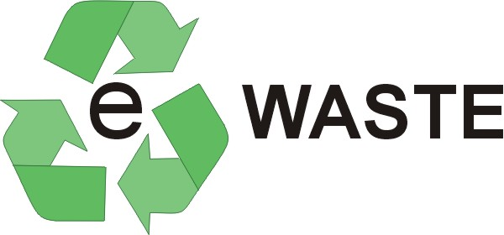
Recycling Of
Technologies currently used in India
    Decontamination.
    Dismantling.
    Pulverization/ Hammering.
    Shredding.
    Density separation using water.
Technologies needed in India
    E-waste trade value chain.
    Environmentally Sound E-waste Treatment Technology.
    CRT treatment technology.

Slide 20
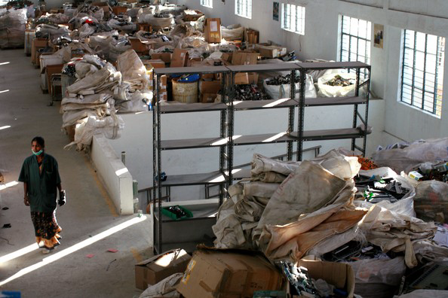
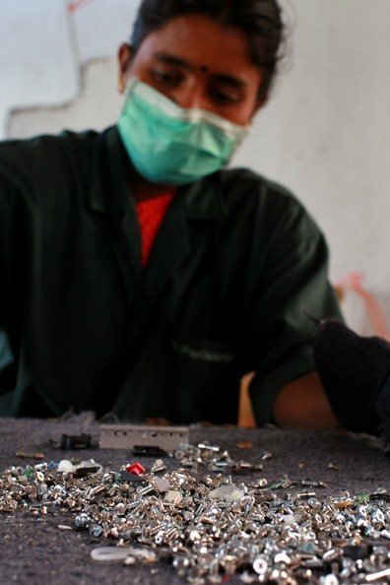
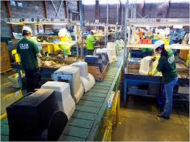
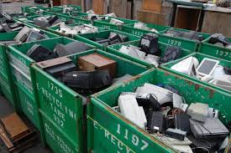

Slide 21

LEGISLATION
Basel Convention
1. Trans-boundary movement of hazardous substances.
2. Ban on land, water fill
3. Environment friendly disposal
European Union, Japan, Korea
1. WEEE Directive w.e.f. 1st July,2007
2. Extended Producers Responsibility-Take Back
3. Treatment by the designated facilities

Slide 22
In the next……
You will be practicing some numericals related to this Chapter on Solid waste management

